Slide 1

Basic Algorithms
Recursion, Greedy, Sorting and Searching
SoftUni Team
Technical Trainers
Software University
http://softuni.bg

Slide 2
Table of Contents
Recursion
Greedy
Sorting
Bubble Sort
Searching
Linear
Binary

Slide 3
Have a Question?
sli.do
#fund-csharp

Slide 4
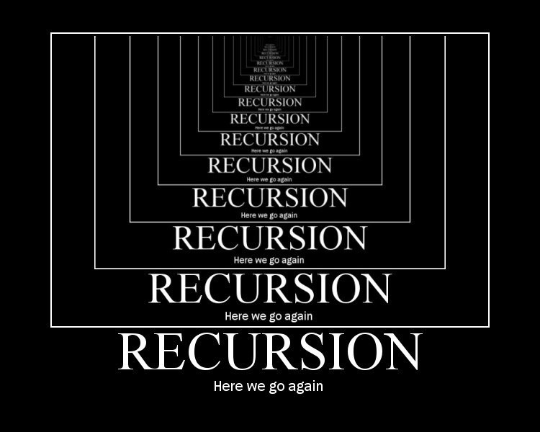
Recursion
What is Recursion?

Slide 5
What is Recursion?
Problem solving technique
Divides a problem into subproblems of the same type
Involves a function calling itself
The function should have a base case
Each step of the recursion should move towards the base case
Sum(array)
array[0] + Sum(sub-array)
1 | 2 | 3 | 4 | 5
1
2 | 3 | 4 | 5

Slide 6
Array Sum – Example
Sum(n - 1)
1
2 | 3 | 4
Sum((n – 1) - 1)
Sum(n)
1
2
3 | 4
1 | 2 | 3 | 4
Sum(((n – 1) - 1) – 1)
1
2
3
4
Base case

Slide 7
Problem: Array Sum
Create a recursive method that
Finds the sum of all numbers stored in an int[] array
Read numbers from the console
1 2 3 4
10
-1 0 1
0

Slide 8
Solution: Array Sum
static int Sum(int[] array, int index)
{
if (index == array.Length - 1)
{
return array[index];
}
return array[index] + Sum(array, index + 1);
}

Slide 9
Direct and Indirect Recursion
Direct recursion
A method directly calls itself
Indirect recursion
Method A calls B, method B calls A
Or even A → B → C → A
void A() {
…
A();
}
void A() {
…
B();
}
void B() {
…
A();
}

Slide 10
Recursion Pre-Actions and Post-Actions
Recursive methods have 3 parts:
Pre-actions (before calling the recursion)
Recursive calls (step-in)
Post-actions (after returning from recursion)
static void Recursion() { // Pre-actions
Recursion();
// Post-actions }

Slide 11
Recursive Factorial – Example
Recursive definition of n! (n factorial):
Pseudocode
N!
5
120
10
3628800
n! = n * (n–1)! for n > 0
0! = 1

Slide 12

Recursion
Live Demo

Slide 13

Brute-Force Algorithms
Trying All Solutions

Slide 14
Brute-Force Algorithms
Trying all possible combinations
Picking the best solution
Usually slow and inefficient
0
0
0
0
0

Slide 15
Brute-Force Algorithms
0
0
0
0
0

Slide 16
Brute-Force Algorithms
0
0
0
0
1

Slide 17
Brute-Force Algorithms
0
0
0
0
2

Slide 18
Brute-Force Algorithms
9
9
9
9
9
10 x 10 x 10 x 10 x 10 = 100,000 combinations

Slide 19

Greedy Algorithms
Picking Locally Optimal Solution

Slide 20
Optimization Problems
In computer science, an optimization problem is the problem of finding the best solution from all feasible solutions
Finding the optimal among many candidates
Examples of optimization problems:
Find the shortest path from Sofia to Varna on the map
Find the maximum increasing subsequence in integer sequence
Traveling salesman problem (minimal Hamilton cycle)
Find the shortest route that visits each city and returns to the origin city

Slide 21
Greedy Algorithms
Greedy algorithms are a category of algorithms
For solving optimization problems
Usually more efficient than the other algorithms
But can produce non-optimal (incorrect) result
Greedy algorithms pick the best local solution
Pick the optimum from their current position & point of view
Greedy algorithms assume always choosing a local optimum leads to the global optimum
This is sometimes correct, but sometimes it is not

Slide 22
1$
1¢
50¢
5¢
25¢
4¢
Sum of Coins
Problem

Slide 23
Greedy Algorithms: Sum of Coins
Consider the US currency coins:
{ 0.01, 0.02, 0.05, 0.10}
Problem "Sum of Coins":
Gather a sum of money, using the least possible number of coins
Greedy algorithm for "Sum of Coins":
Take the largest coin while possible
Then take the second largest
Etc.

Slide 24
Sum of Coins Visualization
Target: 18
10¢
5¢
2¢
1¢
10¢
5¢
2¢
1¢
Actual:
0

Slide 25
Sum of Coins Visualization
Target: 18
10¢
5¢
2¢
1¢
5¢
2¢
1¢
Actual:
10
10¢

Slide 26
Sum of Coins Visualization
Target: 18
10¢
5¢
2¢
1¢
2¢
1¢
Actual:
15
10¢
5¢

Slide 27
Sum of Coins Visualization
Target: 18
10¢
5¢
2¢
1¢
1¢
Actual:
17
10¢
5¢
2¢

Slide 28

Sum of Coins Visualization
Target: 18
10¢
5¢
2¢
1¢
Actual:
18
10¢
5¢
2¢
1¢

Slide 29
Greedy Algorithm for Sum of Coins
Live Demo

Slide 30
Sum of Coins – Solution
int finalSum = 18;
int currentSum = 0;
int[] coins = { 10, 10, 5, 5, 2, 2, 1, 1 };
Queue<int> resultCoins = new Queue<int>();
// Next Slide
Console.WriteLine("Sum not found");

Slide 31
Sum of Coins – Solution(2)
for (int i = 0; i < coins.Length; i++)
{
if (currentSum + coins[i] > finalSum) continue;
currentSum += coins[i];
resultCoins.Enqueue(coins[i]);
if (currentSum == finalSum)
// Sum Found
}

Slide 32


Greedy Failure Cases
Greedy Algorithms Often Fail

Slide 33
Sum of Coins Failure
Target: 18
10¢
5¢
4¢
1¢
10¢
5¢
4¢
1¢
10¢
5¢
4¢
1¢
Actual:
0

Slide 34
Sum of Coins Failure
Target: 18
10¢
5¢
4¢
1¢
10¢
5¢
4¢
1¢
5¢
4¢
1¢
Actual:
10
10¢

Slide 35
Sum of Coins Failure
Target: 18
10¢
5¢
4¢
1¢
10¢
5¢
4¢
1¢
4¢
1¢
Actual:
15
10¢
5¢

Slide 36
Sum of Coins Failure
Target: 18
10¢
5¢
4¢
1¢
10¢
5¢
4¢
1¢
4¢
Actual:
16
10¢
5¢
1¢

Slide 37
Sum of Coins Failure
Target: 18
10¢
5¢
4¢
1¢
10¢
5¢
4¢
4¢
Actual:
17
10¢
5¢
1¢
1¢

Slide 38
Sum of Coins Failure
Target: 18
10¢
5¢
4¢
10¢
5¢
4¢
4¢
Actual:
18
10¢
5¢
1¢
1¢
1¢

Slide 39

Sum of Coins Failure
Target: 18
10¢
5¢
1¢
1¢
1¢
10¢
4¢
4¢

Slide 40

Simple Sorting Algorithms
BubbleSort

Slide 41
What is a Sorting Algorithm?
Sorting algorithm
An algorithm that rearranges elements in a list
In non-decreasing order
Elements must be comparable
More formally
The input is a sequence / list of elements
The output is an rearrangement / permutation of elements
In non-decreasing order

Slide 42

Sorting – Example
Efficient sorting algorithms are important for
Producing human-readable output
Canonicalizing data – making data uniquely arranged
In conjunction with other algorithms, like binary searching
Example of sorting:
Unsorted list
sorting
Sorted list
10 | 3 | 7 | 3 | 4
3 | 3 | 4 | 7 | 10

Slide 43
Sorting Algorithms: Classification
Sorting algorithms are often classified by
Computational complexity and memory usage
Worst, average and best case behavior
Recursive / non-recursive
Stability – stable / unstable
Comparison-based sort / non-comparison based
Sorting method: insertion, exchange (bubble sort and quicksort), selection (heapsort), merging, serial / parallel, etc.

Slide 44
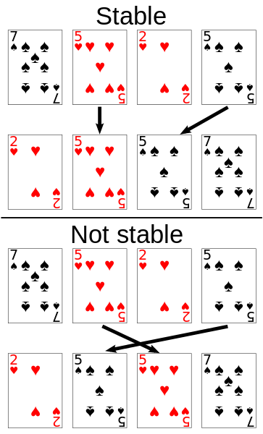
Stability of Sorting
Stable sorting algorithms
Maintain the order of equal elements
If two items compare as equal, their relative order is preserved
Unstable sorting algorithms
Rearrange the equal elements in unpredictable order
Often different elements have same key used for equality comparing

Slide 45
Bubble Sort
Bubble sort – simple, but inefficient algorithm (visualize)
Swaps to neighbor elements when not in order until sorted
Memory: O(1)
Stable: Yes
Method: Exchanging

Slide 46
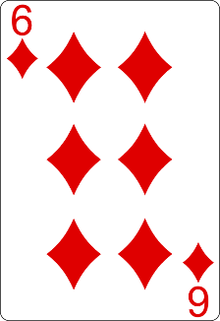
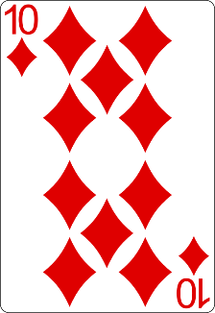
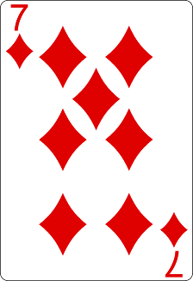
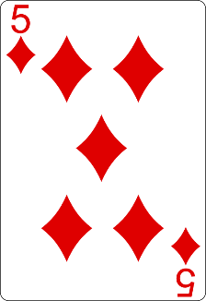
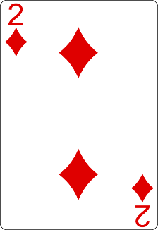
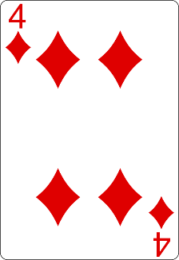
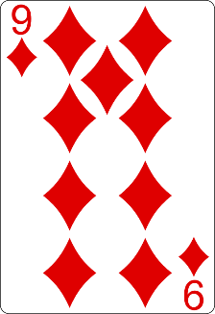
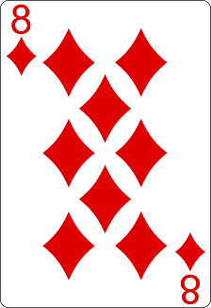
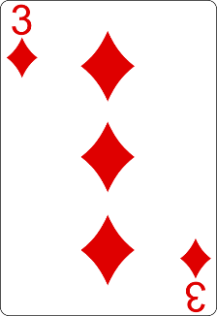
Bubble Sort Visualization
i
j

Slide 47
Bubble Sort Visualization
i
j

Slide 48
Bubble Sort Visualization
i
j

Slide 49
Bubble Sort Visualization
i
j

Slide 50
Bubble Sort Visualization
i
j

Slide 51
Bubble Sort Visualization
i
j

Slide 52
Bubble Sort Visualization
i
j

Slide 53
Bubble Sort Visualization
i
j

Slide 54
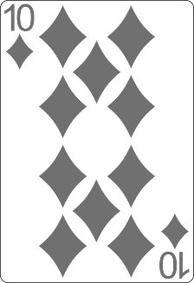
Bubble Sort Visualization
i
j

Slide 55
Bubble Sort Visualization
i
j

Slide 56
Bubble Sort Visualization
i
j

Slide 57
Bubble Sort Visualization
i
j

Slide 58
Bubble Sort Visualization
i
j

Slide 59
Bubble Sort Visualization
i
j

Slide 60
Bubble Sort Visualization
i
j

Slide 61
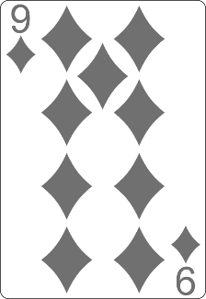
Bubble Sort Visualization
i
j

Slide 62
Bubble Sort Visualization
i
j

Slide 63
Bubble Sort Visualization
i
j

Slide 64
Bubble Sort Visualization
i
j

Slide 65
Bubble Sort Visualization
i
j

Slide 66
Bubble Sort Visualization
i
j

Slide 67
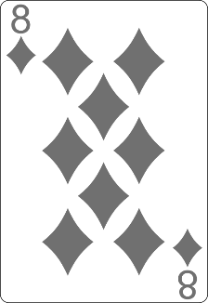
Bubble Sort Visualization
i
j

Slide 68
Bubble Sort Visualization
i
j

Slide 69
Bubble Sort Visualization
i
j

Slide 70
Bubble Sort Visualization
i
j

Slide 71
Bubble Sort Visualization
i
j

Slide 72
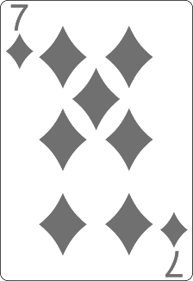
Bubble Sort Visualization
i
j

Slide 73
Bubble Sort Visualization
i
j

Slide 74
Bubble Sort Visualization
i
j

Slide 75
Bubble Sort Visualization
i
j

Slide 76
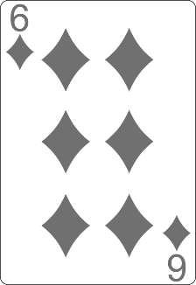
Bubble Sort Visualization
i
j

Slide 77
Bubble Sort Visualization
i
j

Slide 78
Bubble Sort Visualization
i
j

Slide 79
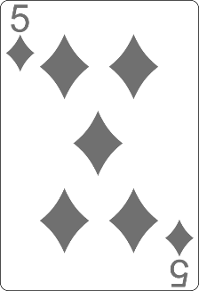
Bubble Sort Visualization
i
j

Slide 80
Bubble Sort Visualization
i
j

Slide 81
Bubble Sort Visualization

Slide 82
BubbleSort
Live Demo

Slide 83
BubbleSort
int[] numbers = { 1, 3, 4, 2, 5, 6 };
for (int i = 0; i < numbers.Length; i++) {
for (int j = i + 1; j < numbers.Length - 1; j++) {
if (numbers[i] > numbers[j]) {
int tempNumber = numbers[i];
numbers[i] = numbers[j];
numbers[j] = tempNumber;
}
}
}
Console.WriteLine(string.Join(" ", numbers));

Slide 84


Searching Algorithms
Linear and Binary Search

Slide 85
Search Algorithm
Search algorithm == an algorithm for finding an item with specified properties among a collection of items
A search typically answers either True or False as to whether the item is present
Also may return where the item is found
The values might be integers, or strings or even other kinds of objects

Slide 86
Linear Search
Linear search finds a particular value in a list (visualize)
Checking every one of the elements
One at a time, in sequence
Until the desired one is found
Worst & average performance: O(n)
for each item in the list:
if that item has the desired value,
return the item's location
return nothing

Slide 87
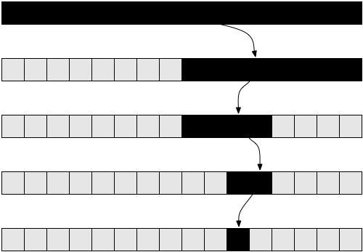
Binary Search
Binary search finds an item within a ordered data structure
At each step, compare the input with the middle element
The algorithm repeats its action to the left or right sub-structure
See the visualization
Complexity: O(log n)

Slide 88
Binary Search (Iterative)
int BinarySearch(int arr[], int key, int start, int end){
while (end >= start) {
int mid = (start + end) / 2;
if (arr[mid] < key)
start = mid + 1;
else if (arr[mid] > key)
end = mid - 1;
else
return mid;
}
return KEY_NOT_FOUND;
}

Slide 89

Summary
…
…
…
Recursion - technique which usually involves a function calling itself
Brute-Force - trying all solutions
Greedy - picking locally optimal solution
Sorting
Bubble Sort
Searching
Linear and Binary

Slide 90
https://softuni.bg/trainings/courses

Slide 91













SoftUni Diamond Partners

Slide 92




SoftUni Organizational Partners

Slide 93




Trainings @ Software University (SoftUni)
Software University – High-Quality Education and Employment Opportunities
softuni.bg
Software University Foundation
http://softuni.foundation/
Software University @ Facebook
facebook.com/SoftwareUniversity
Software University Forums
forum.softuni.bg

Slide 94

License
This course (slides, examples, demos, videos, homework, etc.) is licensed under the "Creative Commons Attribution-NonCommercial-ShareAlike 4.0 International" license

